Slide 1
What is Atomistic Modeling?
Prof. Yuan Ping
Department of Materials Science and Engineering
UW-Madison
Last Update: 9/4/24

Slide 2
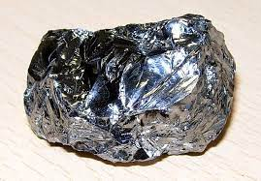
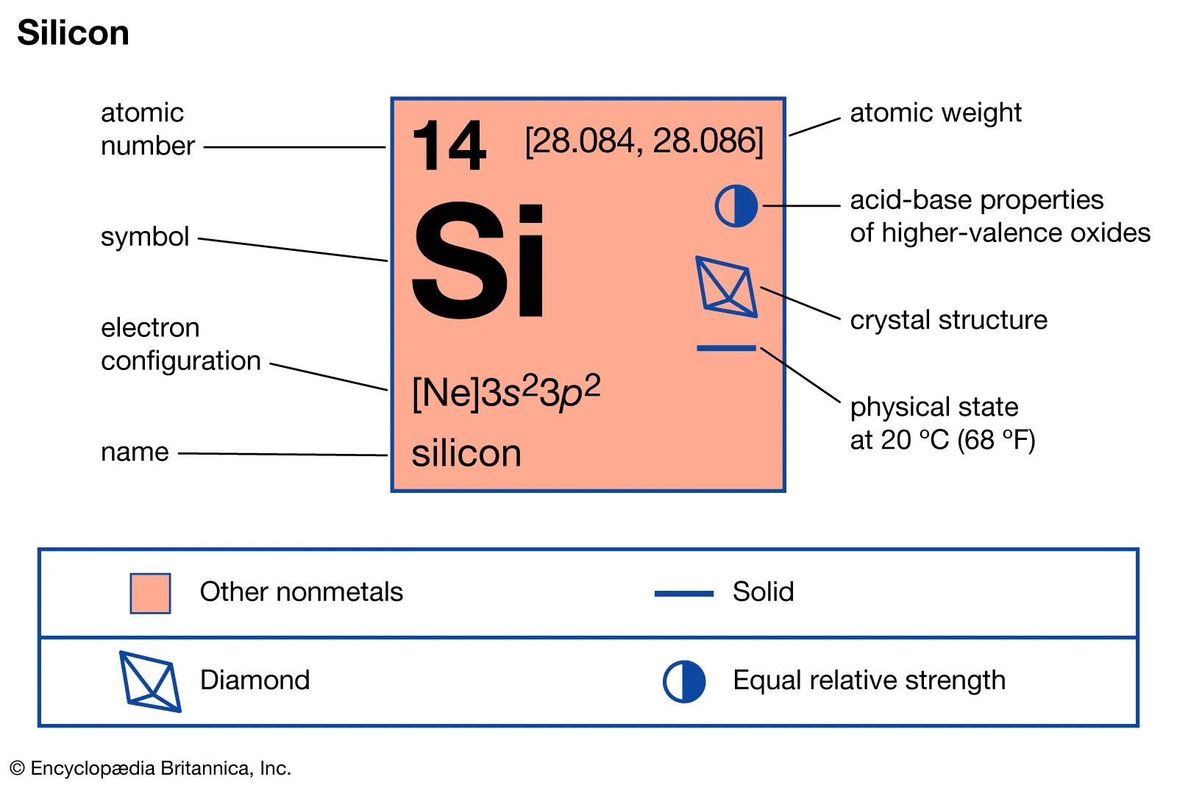
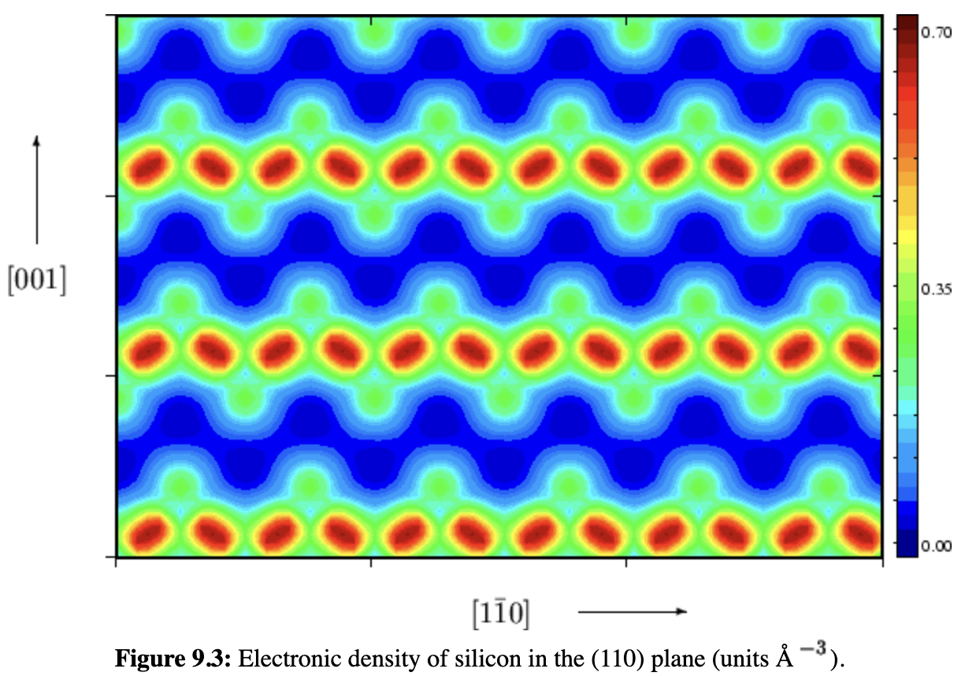
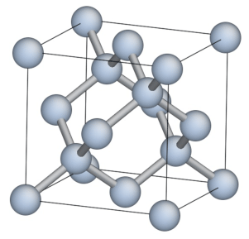
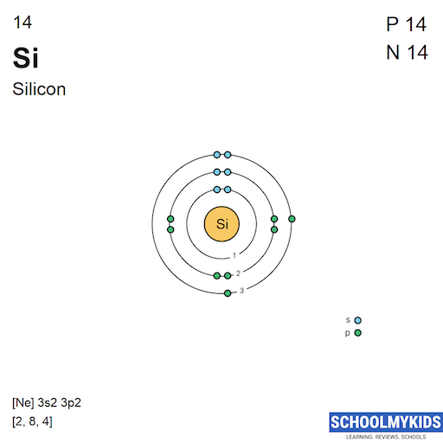
What is Atomistic Modeling?
What is atomistic modeling and how do we use it?
Heirarchical or multiscale modeling
The fundamental modeled properties – electronic structure and energy
FCC

Slide 3
What is Atomistic Modeling?
Using equations that describes how atoms and electrons behave to calculate properties of materials (solids, liquids, gasses, nanoparticles, biomolecules, polymers, etc.)
Structural stability
Electronic structure
Nuclei motion – vibration, rotation, translation
Spectroscopy
Transport
Formation free energy
Band structure, density of states
phonon frequency and modes, dispersion
Electronic and optical excitation,
photoemission, Absorption, Photoluminescence
Carrier mobility, spin diffusion length, mass diffusivity

Slide 4
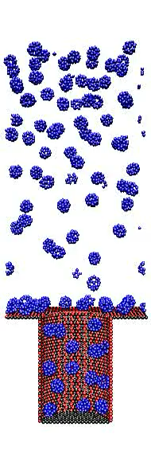
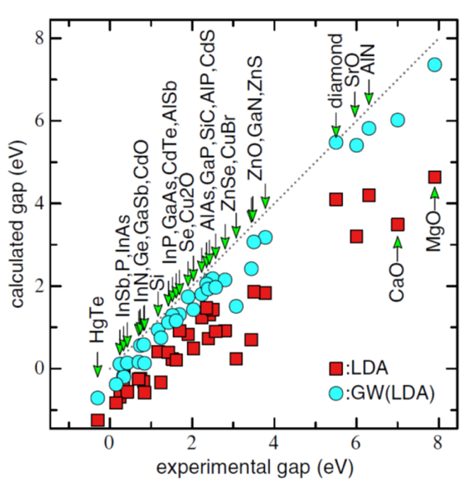
What is Atomistic Modeling?
Layer-by-Layer Assembly of Charged Nanoparticles on Porous Substrates: Molecular Dynamics Simulations, J.-M. Carrillo and A. V. Dobrynin, ACS Nano, 5, 3010-3019 (2011)
Band gap of semiconductors and insulators from QM
M. van Schilfgaarde et al,
Phys. Rev. Lett., 96, 226402 (2006).
layer-by-layer assembly of charged nanoparticles adsorbing out of solution onto a porous substrate with cylindrical pores.

Slide 5
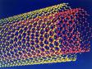
What is Atomistic Modeling?
Using equations that describes how atoms and electrons behave to calculate properties of materials (solids, liquids, gasses, nanoparticles, biomolecules, polymers, etc.)
Examples of atomistic modeling (1 – 10¹⁰ atoms)
Stability and structure of nanoparticles
Band gap and light absorption (color) of nanoparticles
Elastic properties of materials under high-pressure
Radiation damage in steels
Qubit states and operation (quantum defects, quantum dots..)
Magnetic properties of Co, oxides, 2D materials
Catalytic reaction mechanisms
Battery cathode intercalation
Some protein folding problems (may join atoms into interacting molecular units)
And so on …
http://www.nec.com/global/corp/H0602.html

Slide 6
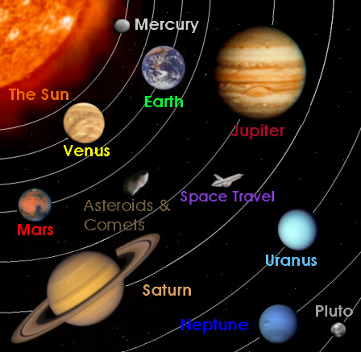
What is Not Atomistic Modeling? Coarse Grained Modeling
Using equations that describes how larger scale entities (coarse-grained groups of atoms) behave to calculate properties of materials/systems
Examples >≈ 10⁵ atoms to 10¹⁰⁰
Finite element method
Elasticity theory
Fluid dynamics
Car crash simulations
Plate tectonics
Planetary orbits
http://library.thinkquest.org/25097/graphics/g_main.htm

Slide 7
Atomistic Modeling Pros and Cons When do we use it?
Pros: Gives complete modeling of every atom virtually on the computer so has the potentials to answer any questions about a group of atoms (which covers almost everything!)
Cons
Limited accuracy (quantitative (e.g., band/HOMO-LUMO gaps), and qualitative (e.g., wrong ground state for strongly correlated systems))
Limited time and spatial scales
We use atomistic modeling when the physics can be treated accurately on the length and time scales accessible to atomistic simulation!

Slide 8
Heirarchical/Multiscale Modeling
If you can directly calculate a property of interest w/atomistic modeling then do it!
If you cannot directly calculate the properties of interest then sometimes you can calculate parameters that can be used in a higher-level model (longer length-time scales) to calculate the property
Example
What is the rate of mixing (interdiffusion) of two metals at high-temperature when put in contact (cladding/fuel in reactor, Cu wires on Si)
Direct simulation of mixing is very slow with molecular dynamics
Can simulate fundamental diffusion constants and then solve diffusion equations

Slide 9
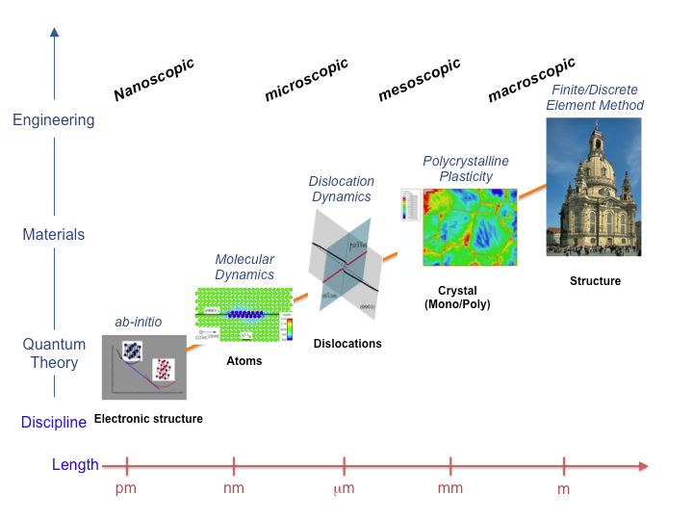
The Multiscale Modeling Picture Choose your methods based on length/time scales
1nm³ Si ≈ 50 atoms
1cm³ Si ≈ 10²² atoms
http://tu-freiberg.de/fakult4/imfd/cms/Multiscale/multiscale.html

Slide 10
Essential Atomic Scale Properties
Electronic structure – what are the electrons doing
Electronic wavefunctions, energies
Charge density
Band structure
Electrical conductivity, optical properties, nature of bonding (ionic vs. covalent), polarization, ionization, valence state, magnetic moments
Energy – how stable are your atoms
Equilibrium positions, lattice parameters
Forces on atoms (first derivatives of energy)
Elastic properties, phonons (second derivatives of energy)
Phase stability
Kinetics (depends on forces, energy barriers)
Thermodynamics (depends on energies)

Slide 11
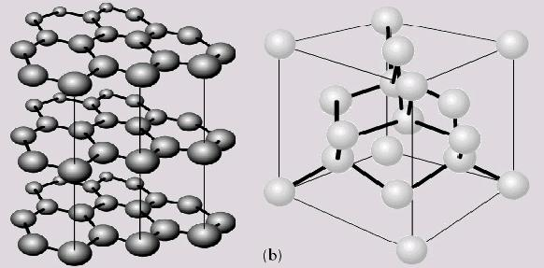
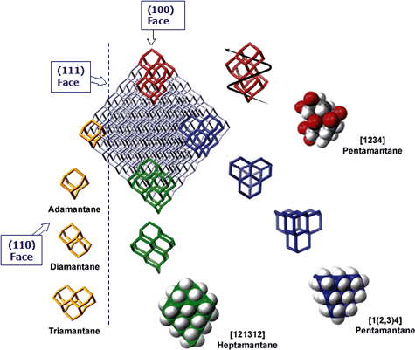
A Good Atomistic Modeling Application: Carbon!
Carbon has many structures – graphite, diamond, nanotubes, buckyballs, diamondoids, …
Electronic structure
What kind of bonding (sp2, sp3, …)
Optical properties: band gap
Conduction: metallic vs. insulating
Energetics
Stability
Atom positions
Thermal conduction: phonon spectra
Mechanical properties: elastic constants, hardness
http://www.chem.latech.edu/~upali/chem281/image0HQ.JPG
http://www.chevrontexaco.com/moleculardiamond/diamondtech/discovery.asp
http://www.nec.com/global/corp/H0602.html

Slide 12
Summary
Atomistic modeling uses basic laws of physics that apply at atomic scales to calculate properties of interest.
Atomistic modeling differs from coarse-grained approaches (continuum modeling) that do not treat atoms explicitly.
Atomistic modeling yields information about electronic structure and energy, from which many problems can be modeled.

Slide 13
END

